Slide 1
Covid-19 Symptoms Classification
Jason Zhang
2/3/2021

Slide 2

Objective
To identify whether any person is having covid-19 disease or not, based on symptoms.

Slide 3
Background
Covid-19
Where
Infectious disease caused by a novel coronavirus
First case found in WuHan, China
When
What
First case found in
Dec 2019
Attack lung and other organs
How
Now
Spread through air from physical contact or close distance
107 Million global cases reported

Slide 4
Background
Short Breath
Cough
Covid-19 Major Symptoms
Sore Throat
Fever
Fatigue

Slide 5
Data Source
Source: Israeli Ministry of Health
Data Features:
Sample Size: n=278,848
01
Demographic
Sex
Age
02
Symptom
Cough
Fever
Sore Throat
Shortness of Breath
Headache
03
Testing Result
Test Date
Contact Indication
Test Result

Slide 6

Methodology
Exploratory Data Analysis
Feature Engineering
Classification Model
Logistic Regression
Naive Bayes
Random Forest
XGBoost
Model Comparison

Slide 7
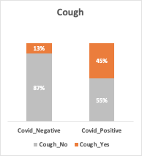
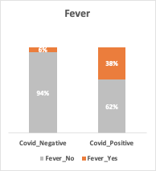
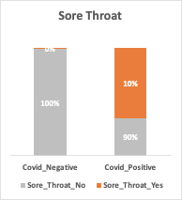
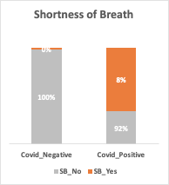
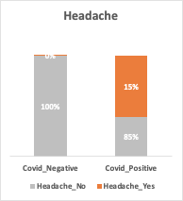
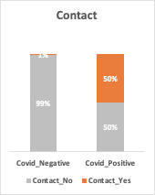
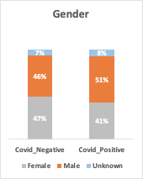
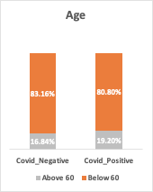
Exploratory Data Analysis

Slide 8
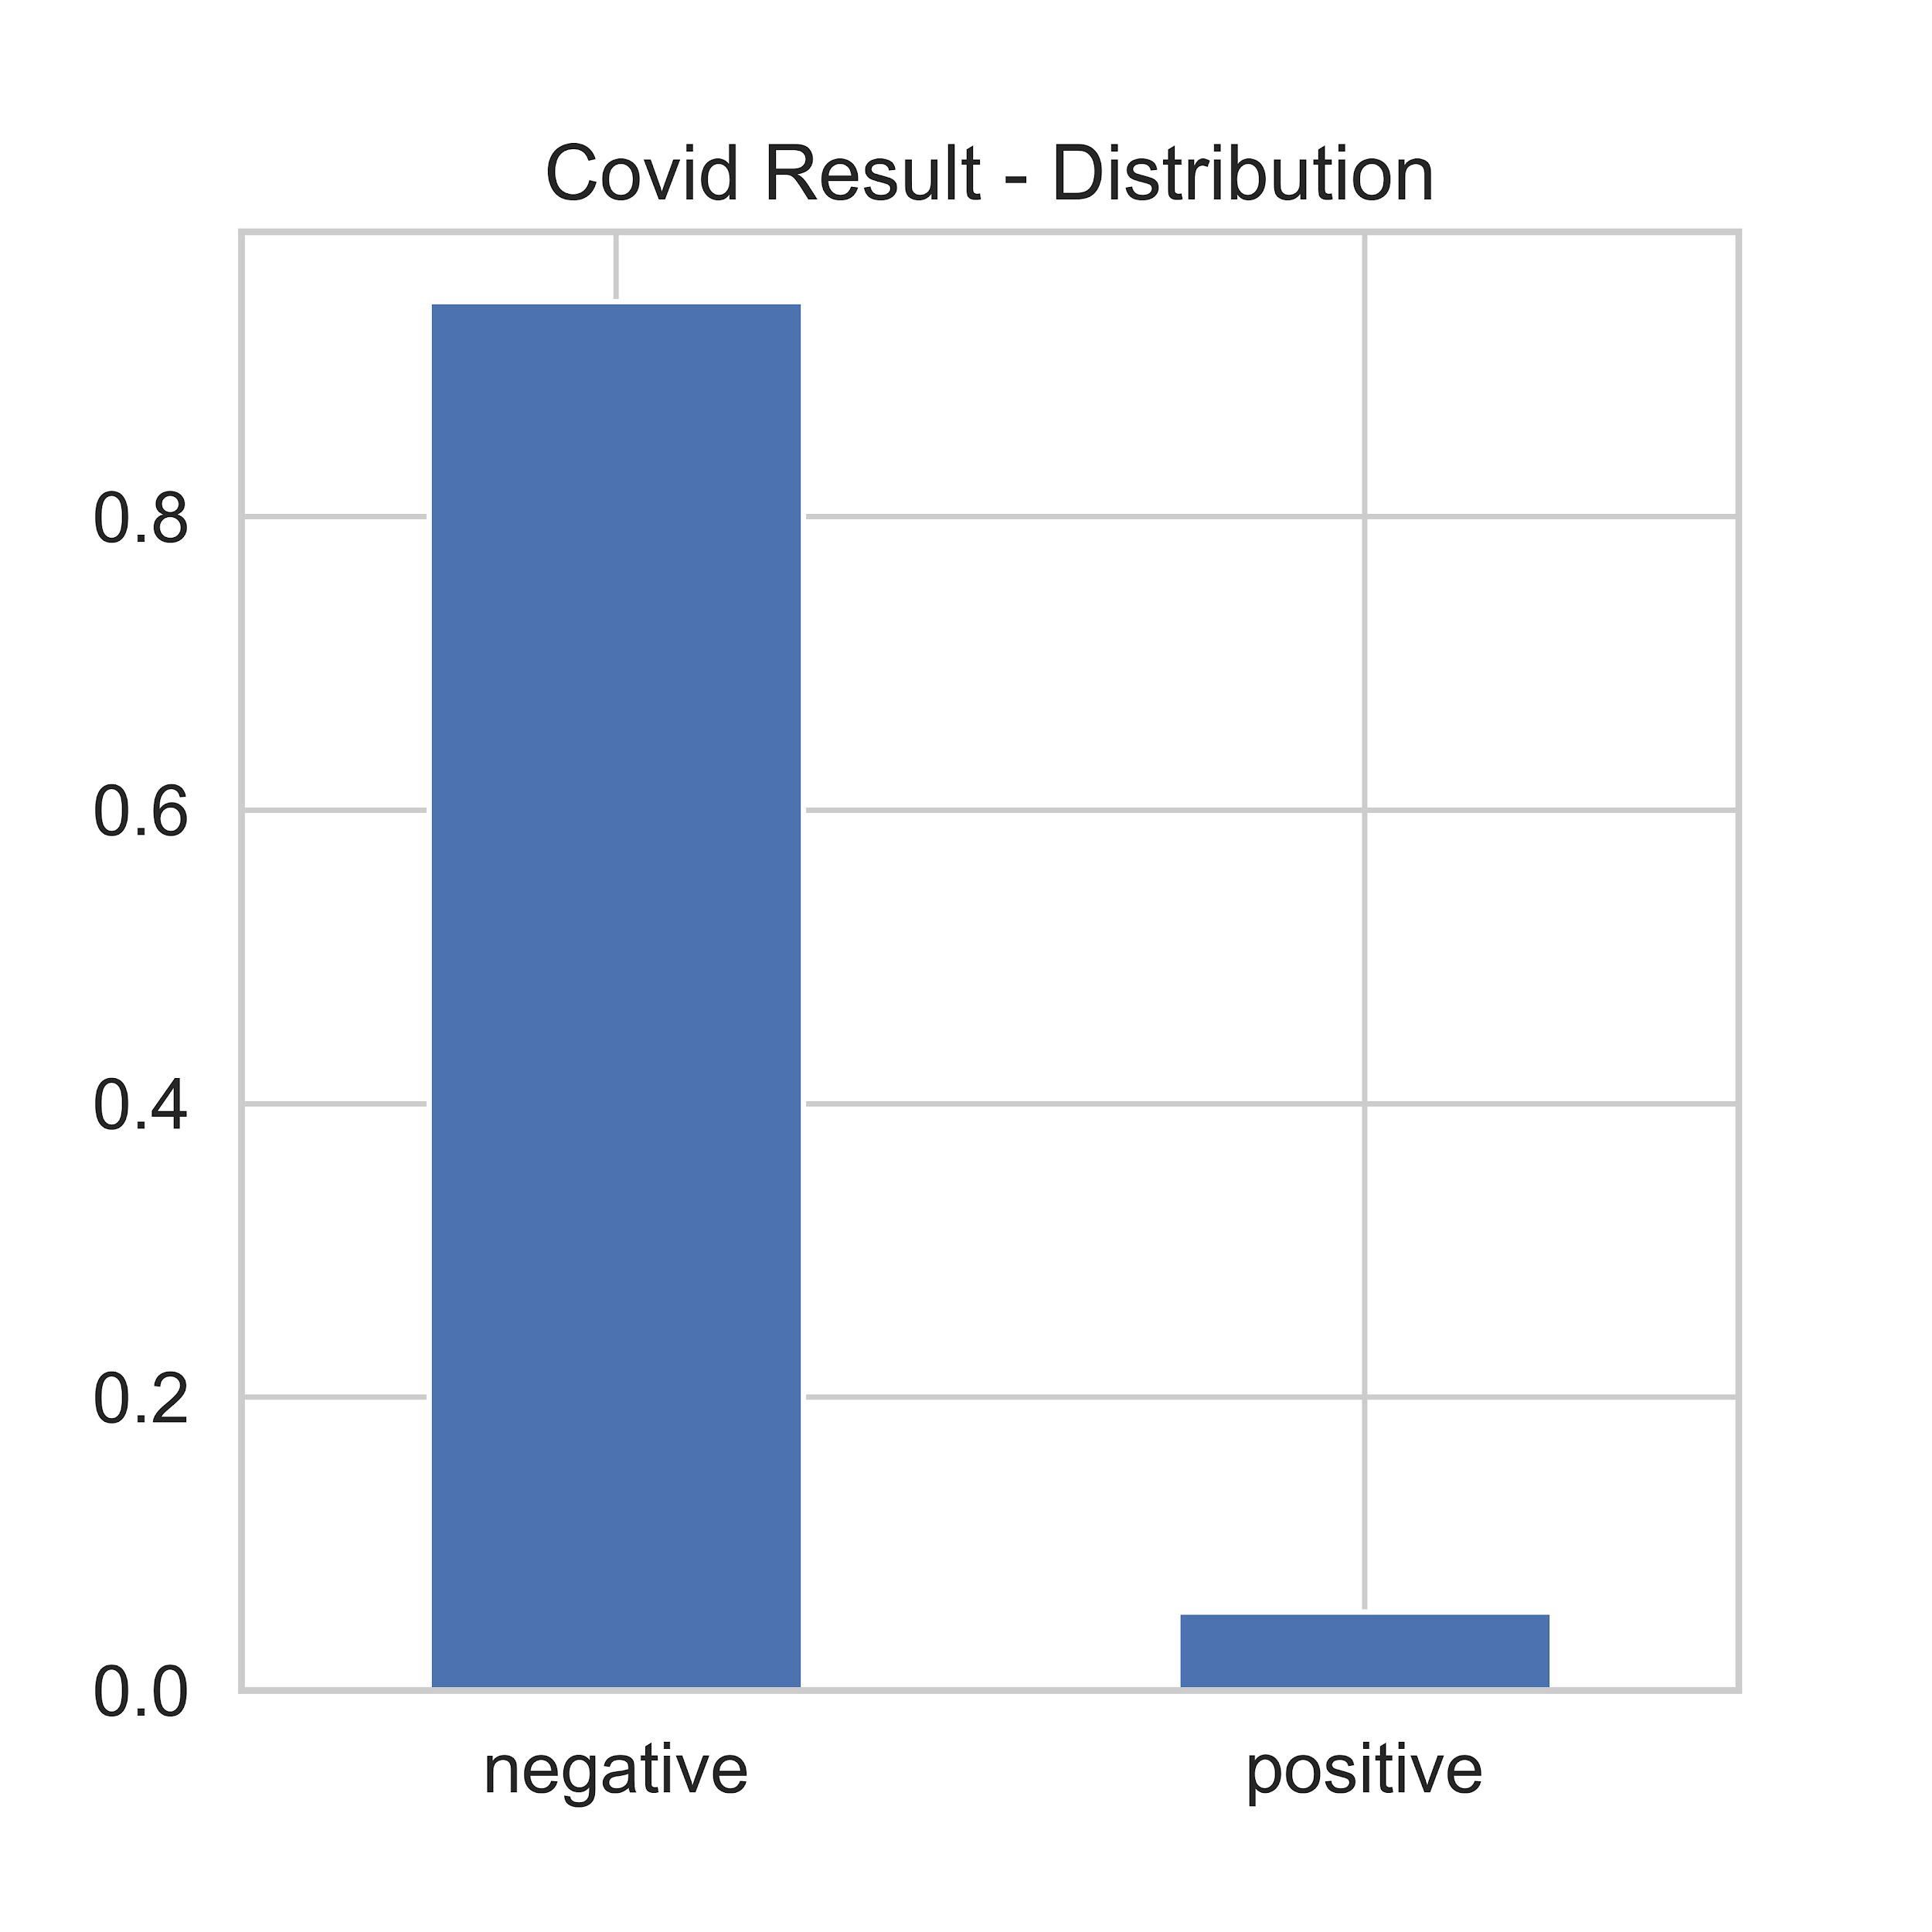
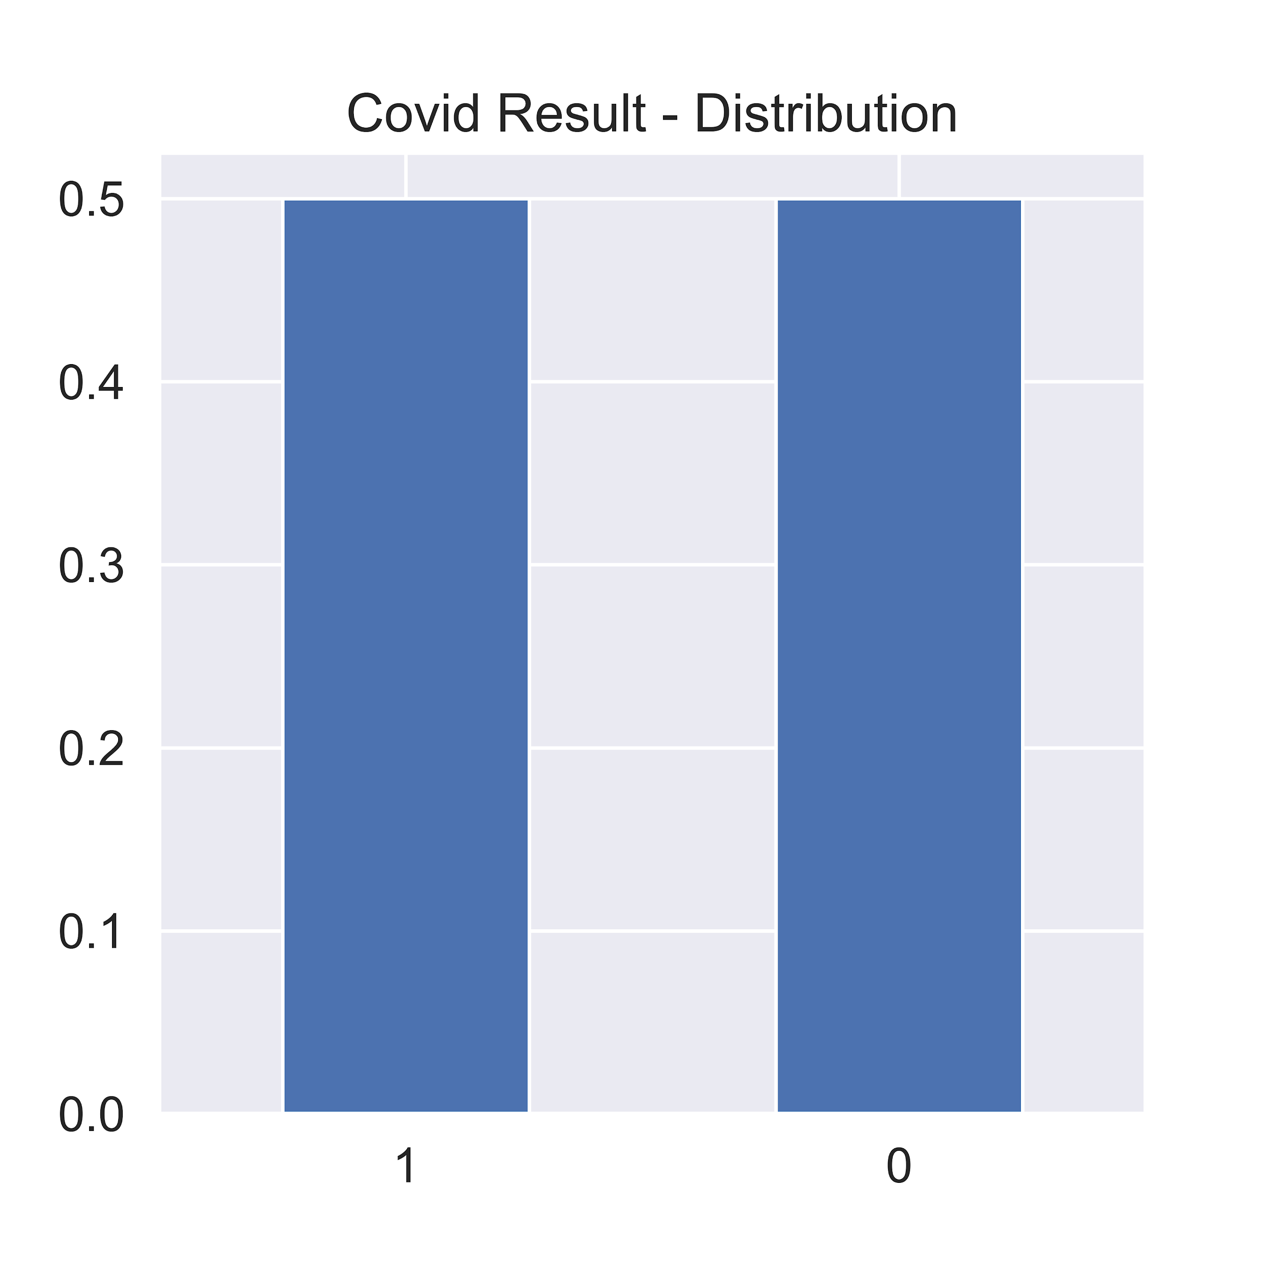
Feature Engineering
Raw Data - Imbalanced
New Data - Balanced
Synthetic Minority Oversampling
Negative
Positive
Negative
Positive

Slide 9
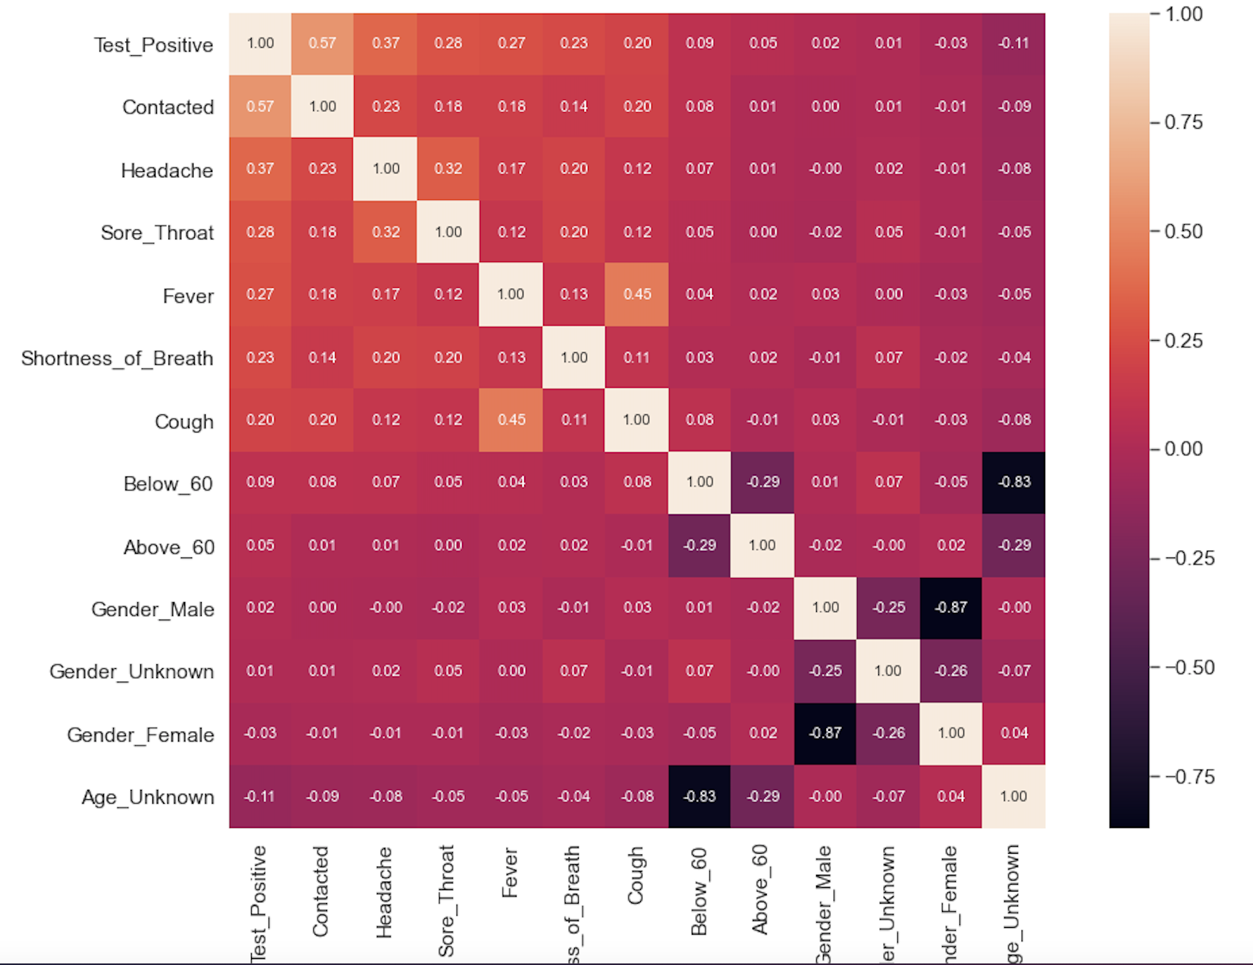
Feature Engineering

Slide 10
Model Results
Features Selected: Cough, Fever, Sore_Throat, Shortness_of_Breath, Headache, Contacted
Goal: Max Recall
Model | Accuracy | Precision | Recall | F1-Score | AUC-Score
Logistic Regression | 82.51% | 92.67% | 75.21% | 80.19% | 82.53%
Naive Bayes | 84.06% | 91.45% | 75.21% | 82.54% | 84.07%
Random Forest | 83.83% | 91.44% | 74.71% | 82.23% | 79.84%
XGBoost | 83.16% | 84.10% | 81.84% | 82.96% | 83.15%

Slide 11
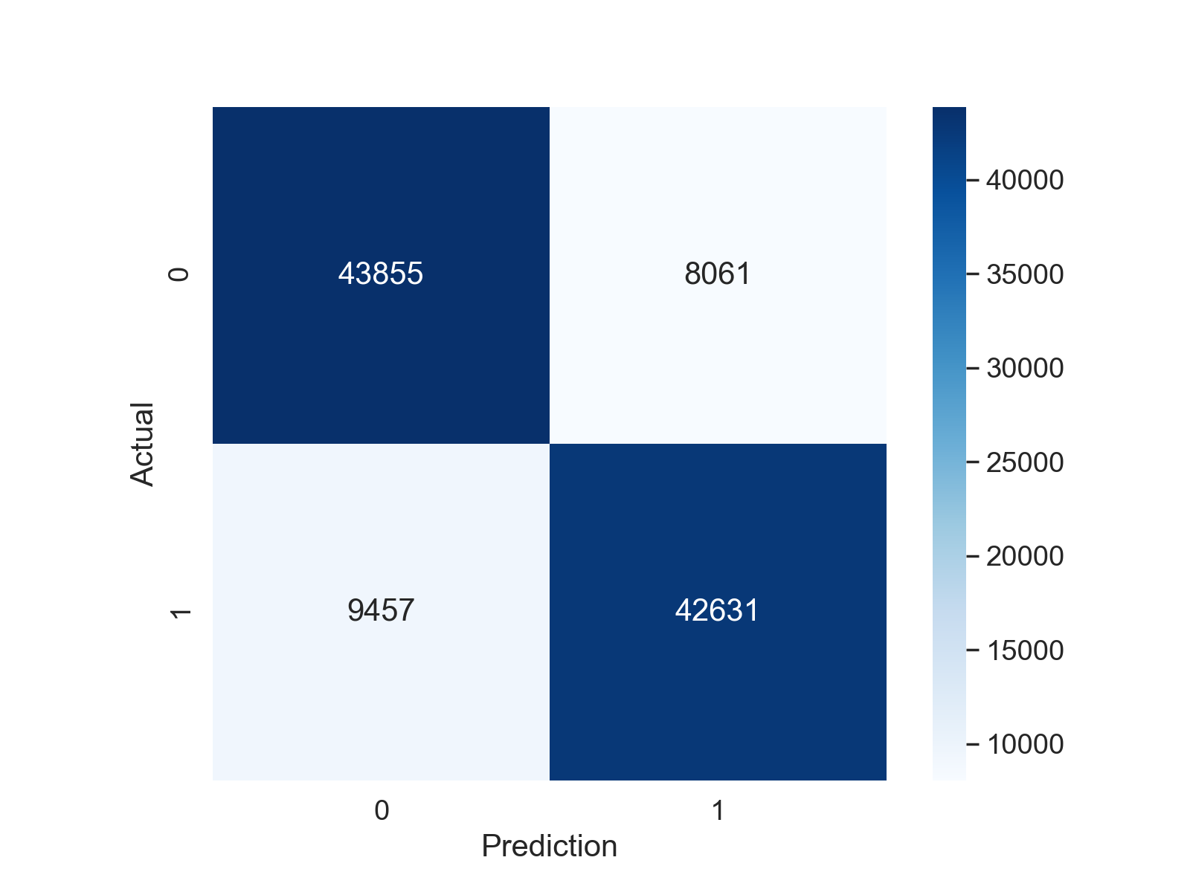
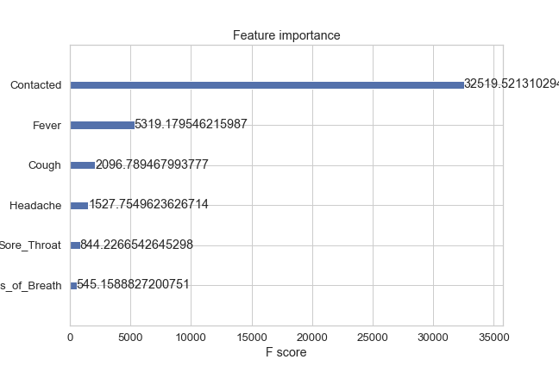
Confusion Matrix & Feature Importance
Negative
Positive
Negative
Positive

Slide 12
Future Work
Add more types of symptoms (Diarrhea, Chest Pain, Nasal-Congestion)
Collect more positive cases data
Tunning Model with more robust algorithms

Slide 13
Questions?

Slide 14
Appendix 1 - Data Source
Data Source Website: https://github.com/nshomron/covidpred

Slide 15
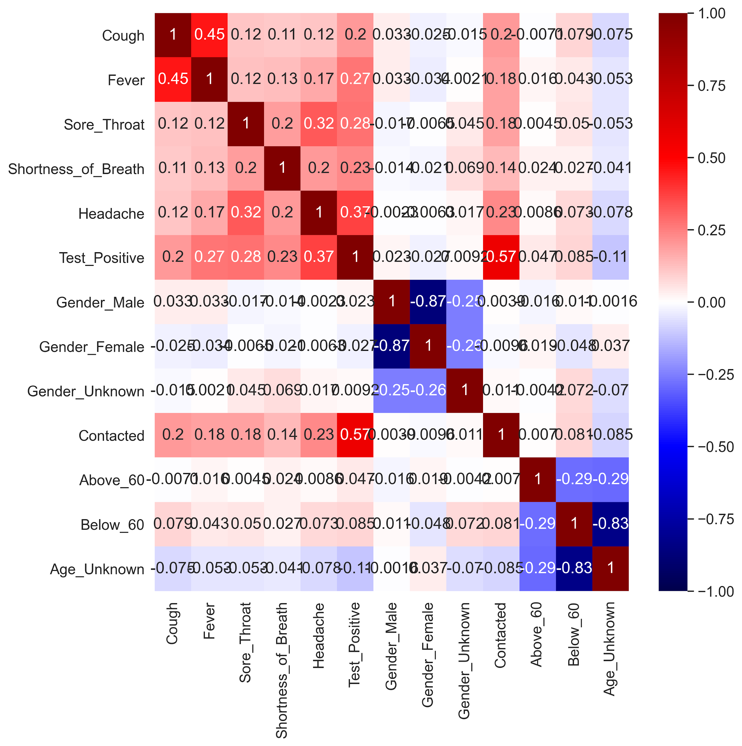
Appendix 2 - Heatmap

